Slide 1
Football Dataset
Presented By
Sahadev Sutradhar
Bach No: ML3-DA23

Slide 2
Objective
To find out Players Market Values.
To Analysis the Performance of Players.
To find out Top 5 Home Club and Away Club.
To find out Top 5 Referee in the Game.
To find out how many Player has got Red Card and Yellow Card.
To find out Highest Score player in the Game.

Slide 3




Data Treatment process
Checking Null Values
Checking Duplicated Values
Filling Null Values
Checking the data type
Displaying all the columns
Joining the Table

Slide 4
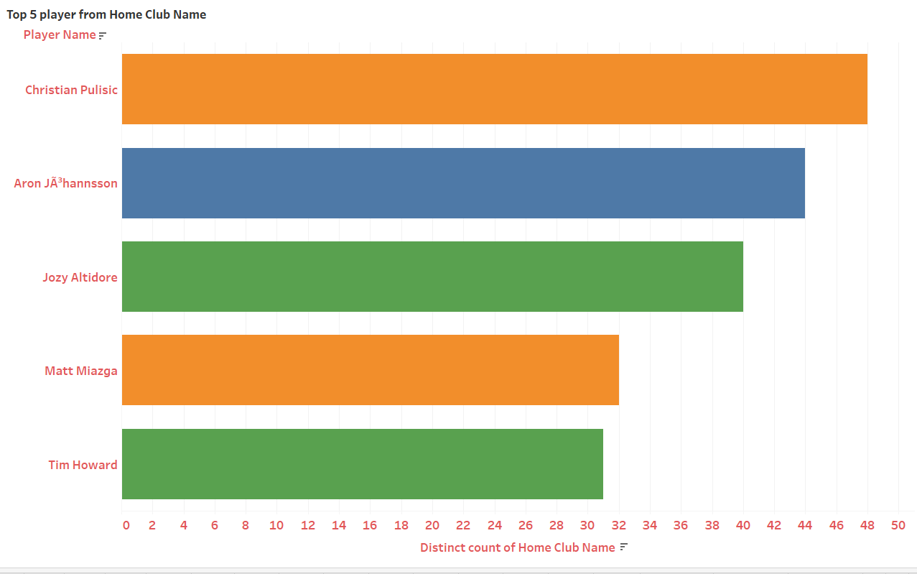
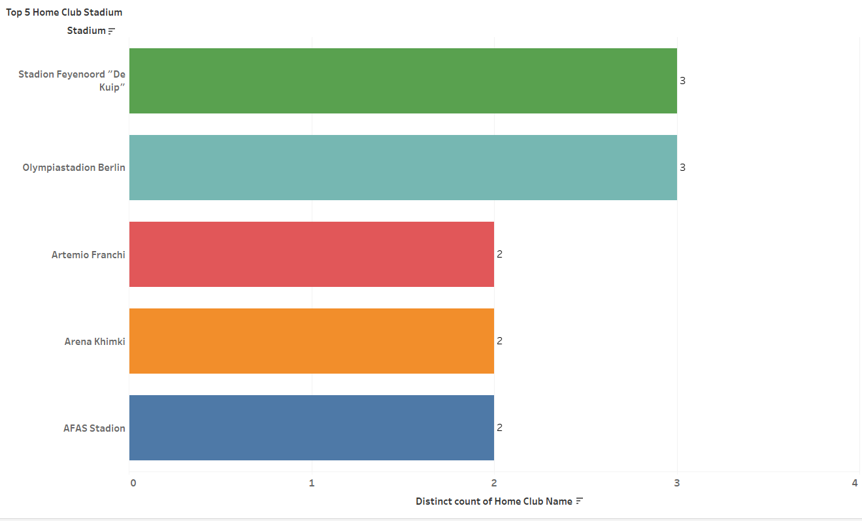
Which Top 5 Players are Pleaded in their Home Club?
What are the Top 5 Home Club Stadium?
Christian Publisic is the Highest in the Home Club
Stadion Feyenoord and Olymoliastadion Berlin has the top Home Club

Slide 5
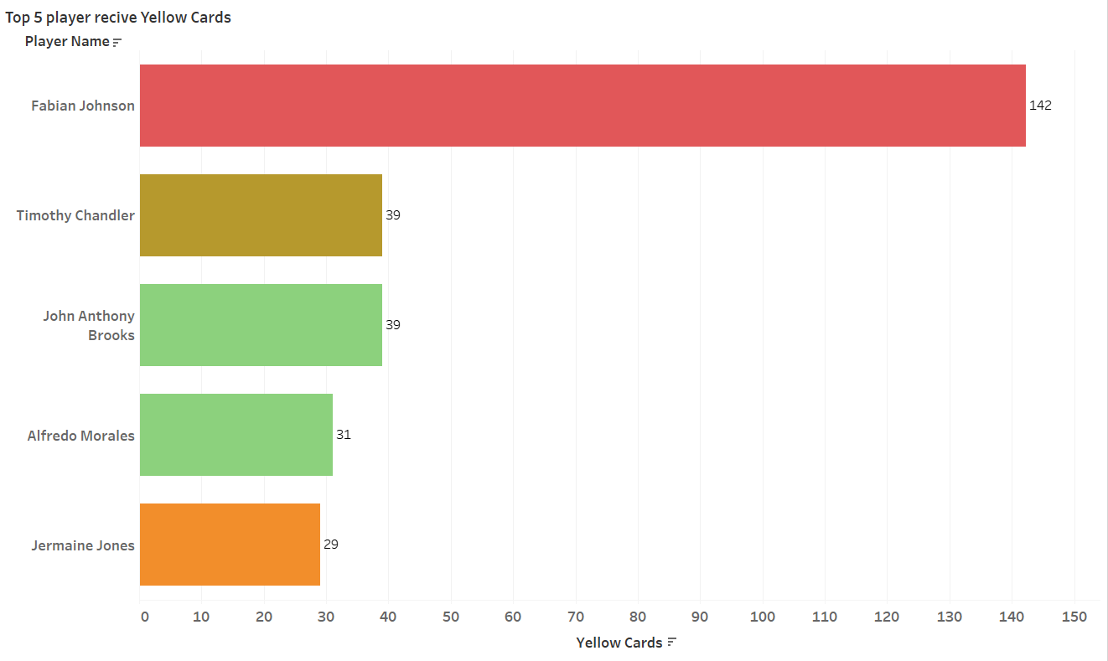
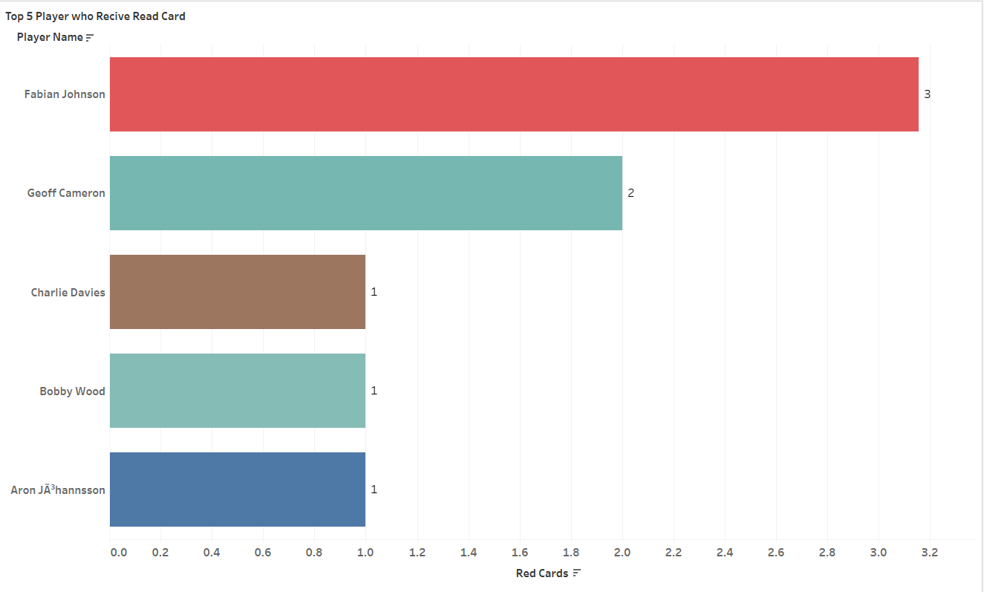
Which are the Top 5 Player who got Read Card?
Which are the Top 5 player who receive Yellow Card?
Fabian Johnson have received highest number of Red Card 3 time
Fabian Johnson have received highest number of Yellow Card 142 time

Slide 6
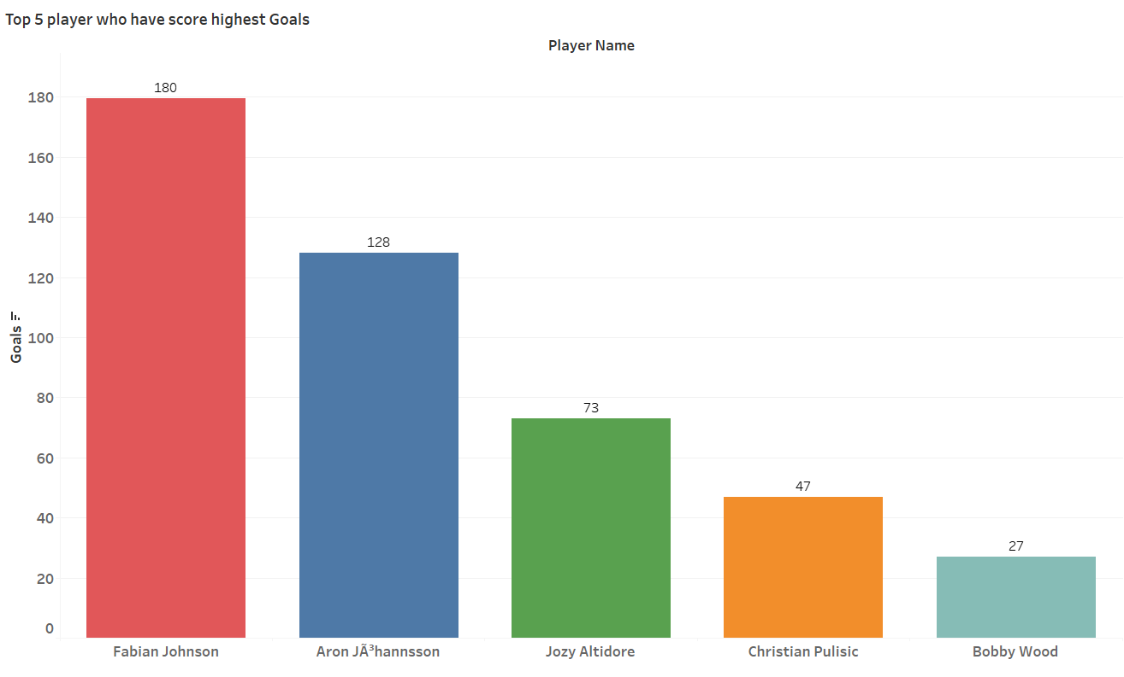
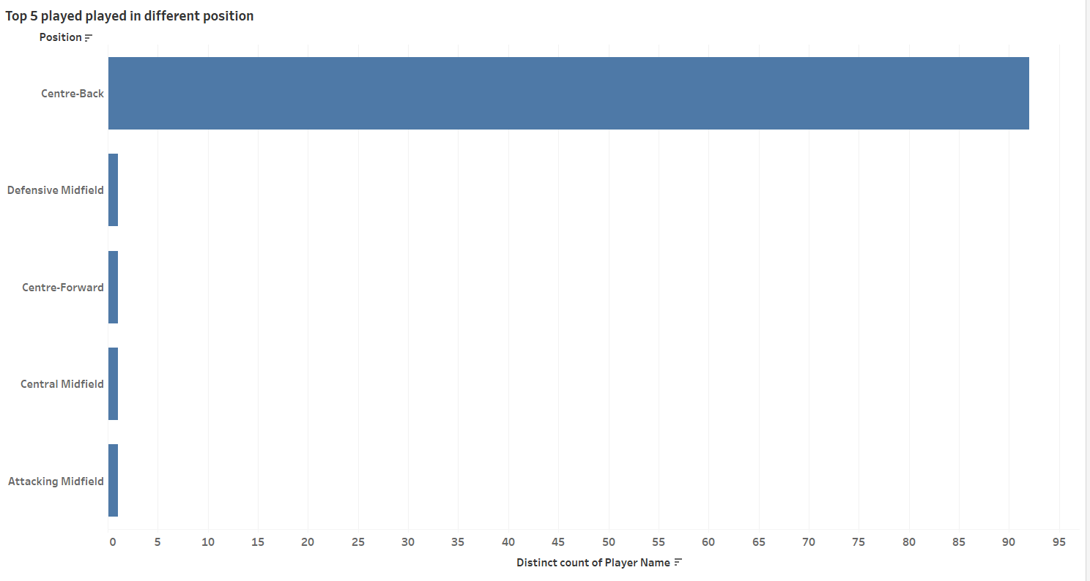
Which are the Top 5 Players Played in different position?
Which are the Top 5 player who score Highest Goals?
Highest number of Player Played Centre-Back Position
Fabian Johnson has Score Highest number of Goals

Slide 7
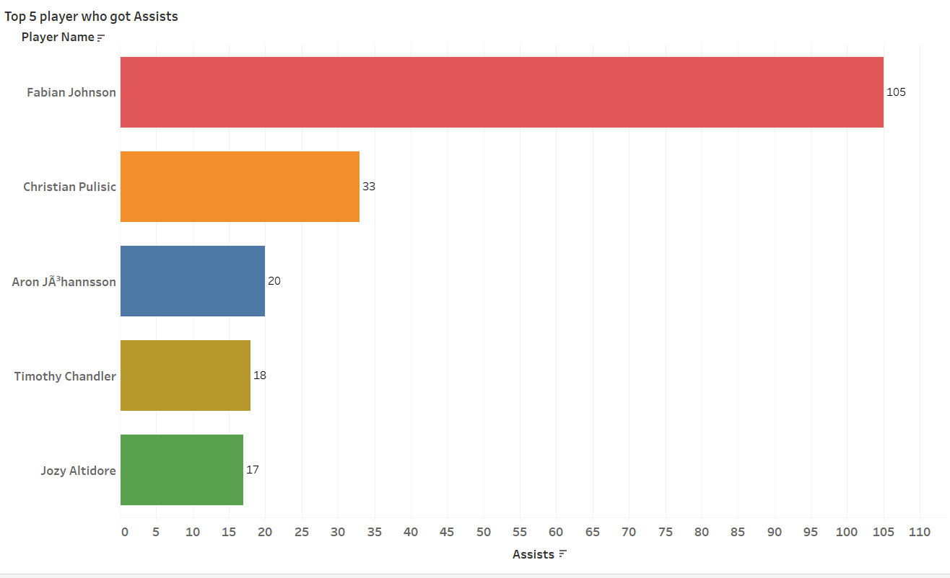
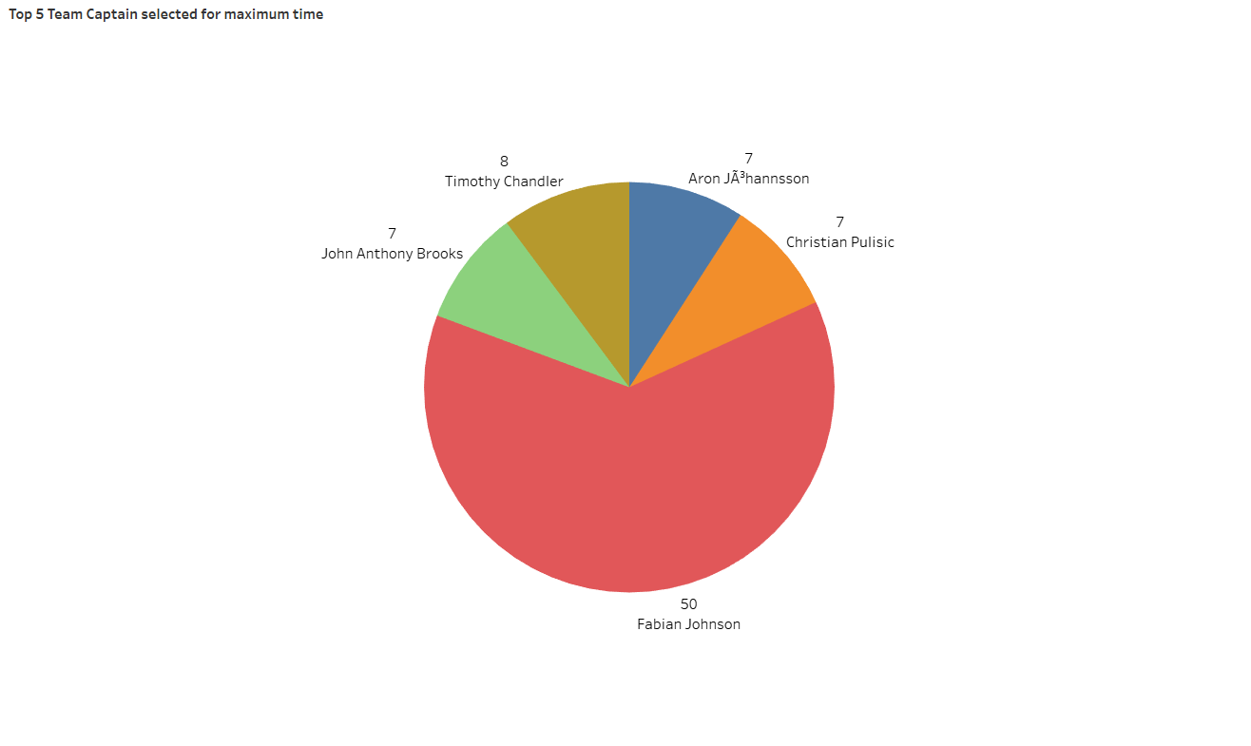
Which are the Top 5 player got assist in the Game?
Which are the player who got selected maximum time for Team Captain?
Febian Johnson has highest number Assists
Fabian Johnson have selected highest number of Team Captain

Slide 8
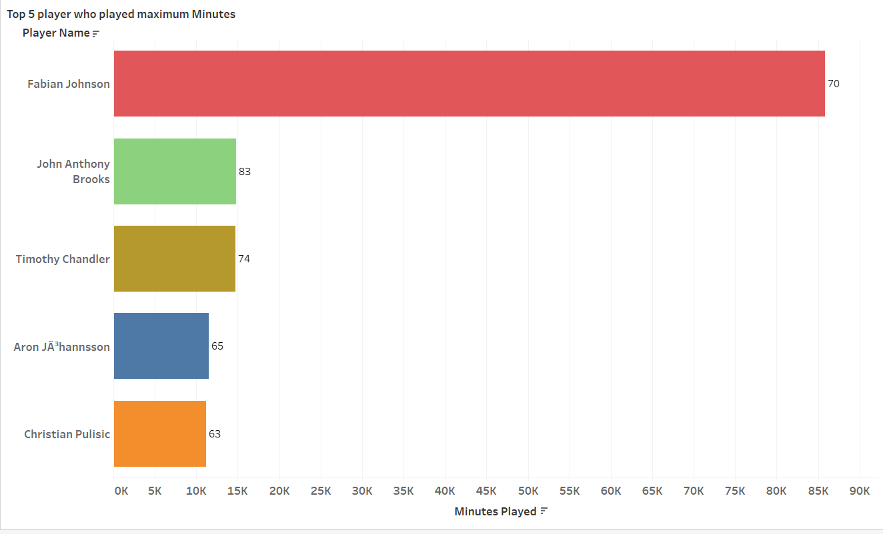
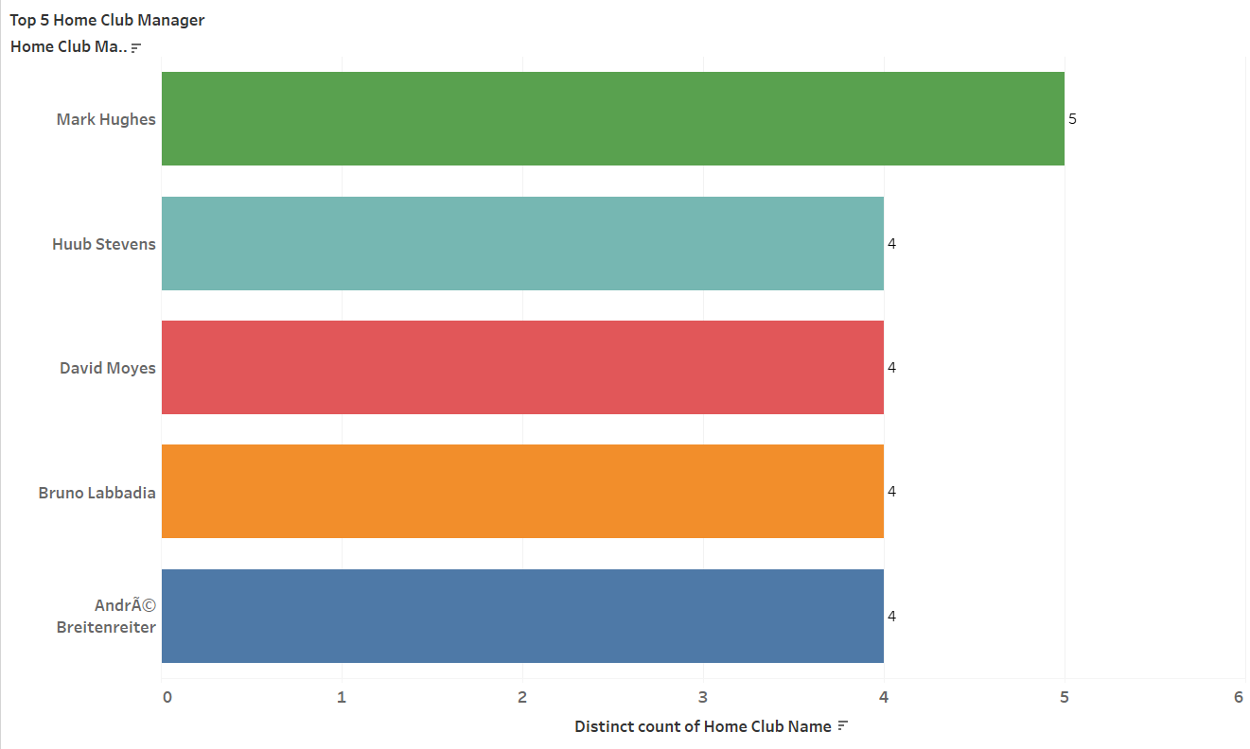
Which are the top5 player who played Maximum Minutes in the Game?
Which are the Top 5 Home Club Manager according to the Home club Name?
Fabian Johnson has played Maximum Minutes in the Game
Mark Hughes is the top Home Club in the Game

Slide 9
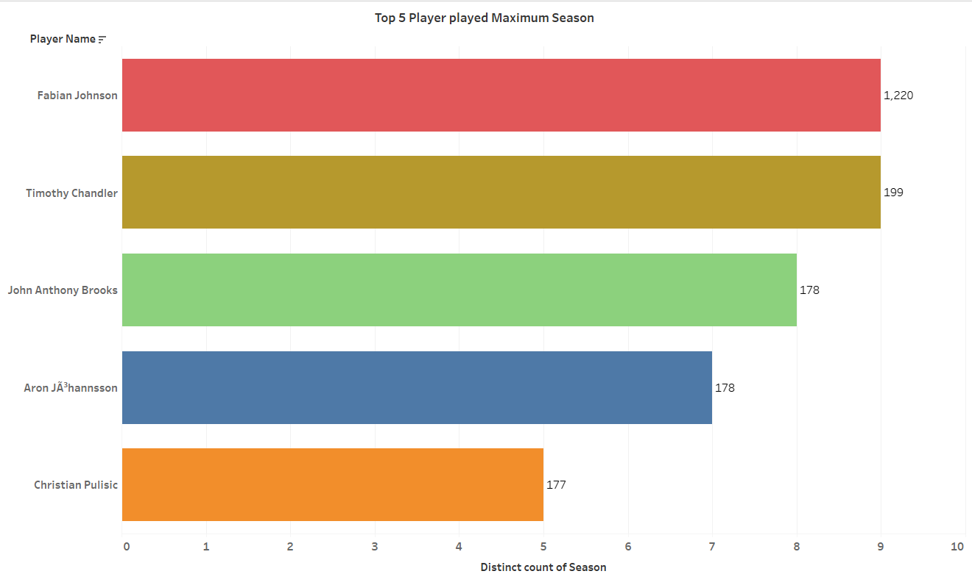
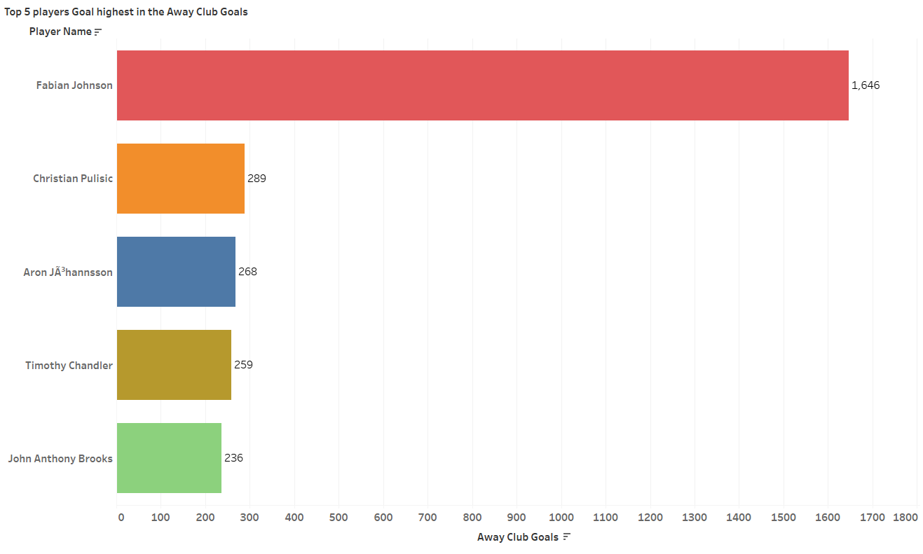
Which are the Top 5 player played in Maximum Season?
Which are the player who goals highest in the Away club Goals?
Fabian Johnson have played highest 1220 Season
Fabian Johnson have got highest number of goal in the Away Club Game

Slide 10
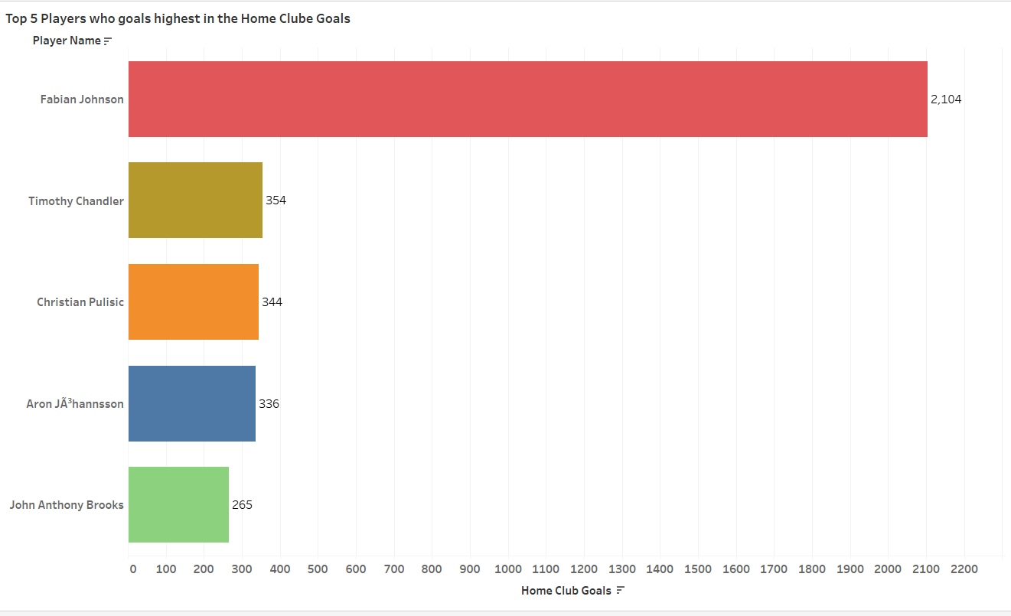
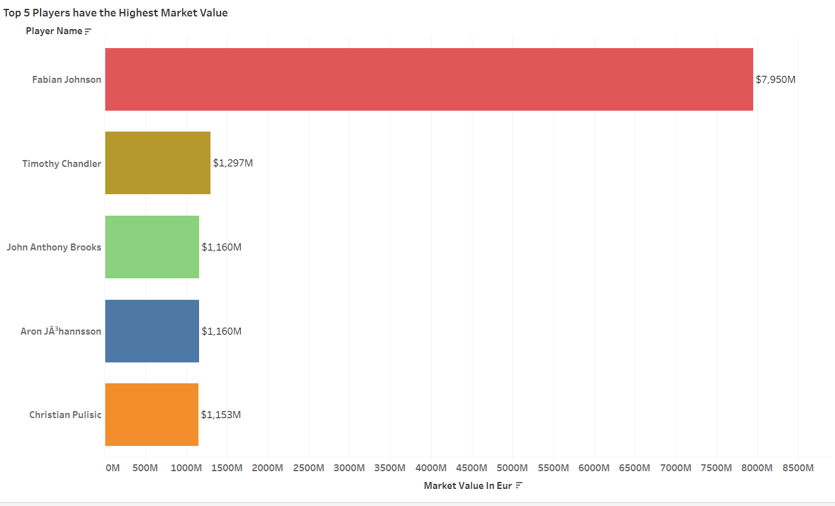
Which are the player who goals highest in the Home Club Goals?
Which are the Top 5 player who have highest Market values?
Fabian Johnson have got highest number of goal in the Home Club Game
Fabian Johnson has highest Market Value that is $7,950M

Slide 11
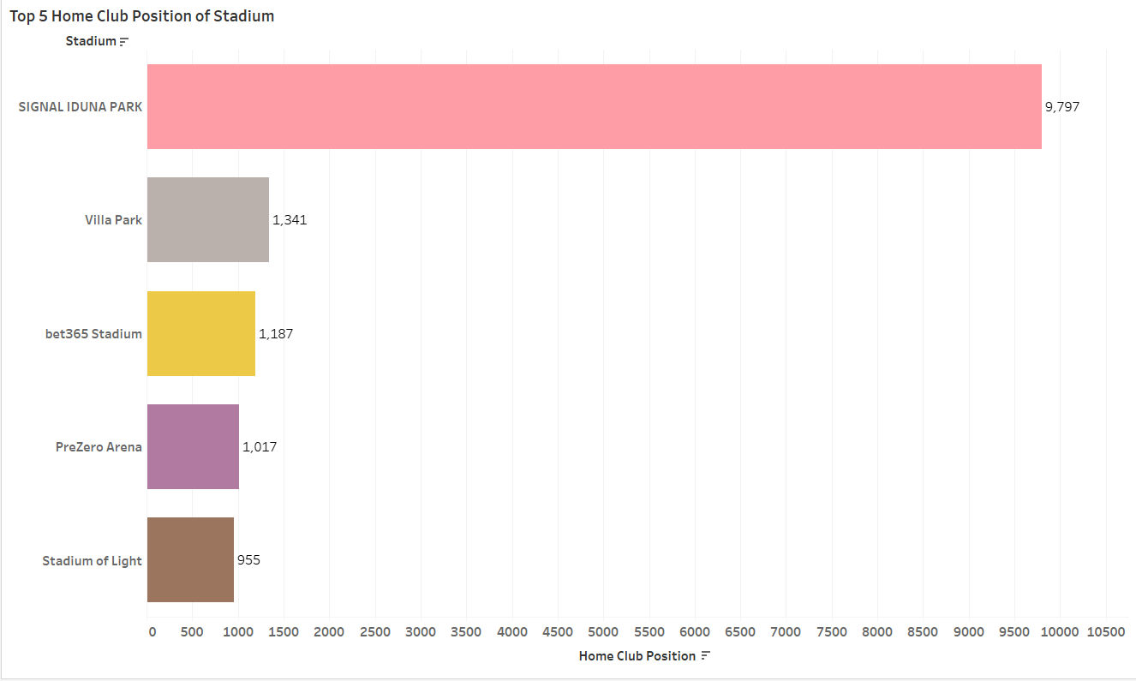
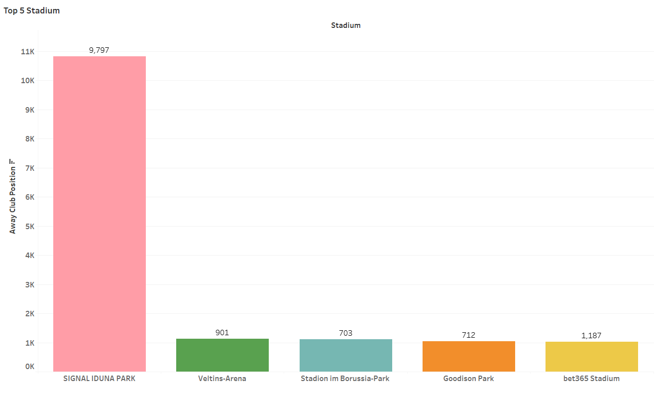
What is the Top 5 Home Club Position of Stadium?
What are the top 5 Away Club Position of the Stadium?
Signal Iduna Park is the highest Home Club Position of Stadium
Signal Iduna Park is the highest Away Club Position of Stadium

Slide 12
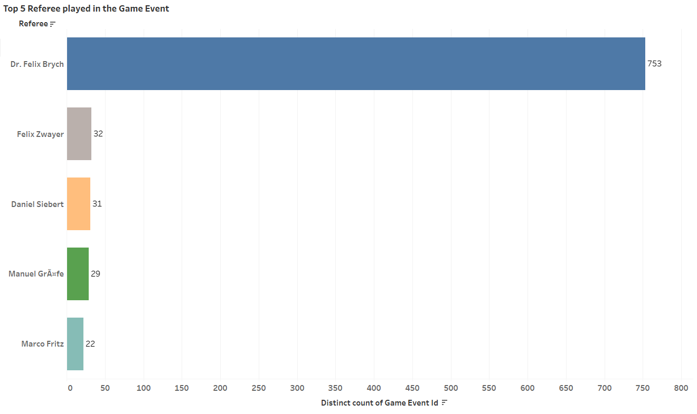
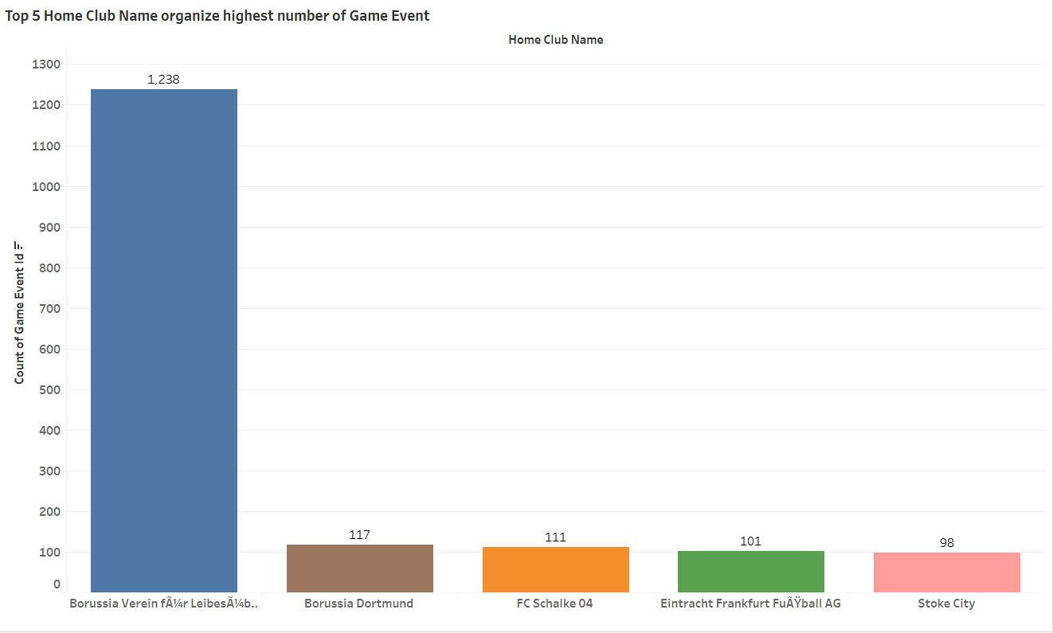
Which are the top 5 Referee played in the Game?
Which are the top 5 Home club Name who organized highest numbers of Game Event?
Dr. Felix Brych is the highest paid Referee in the Game
Borussia Verein Club have organize highest number of Game Event

Slide 13
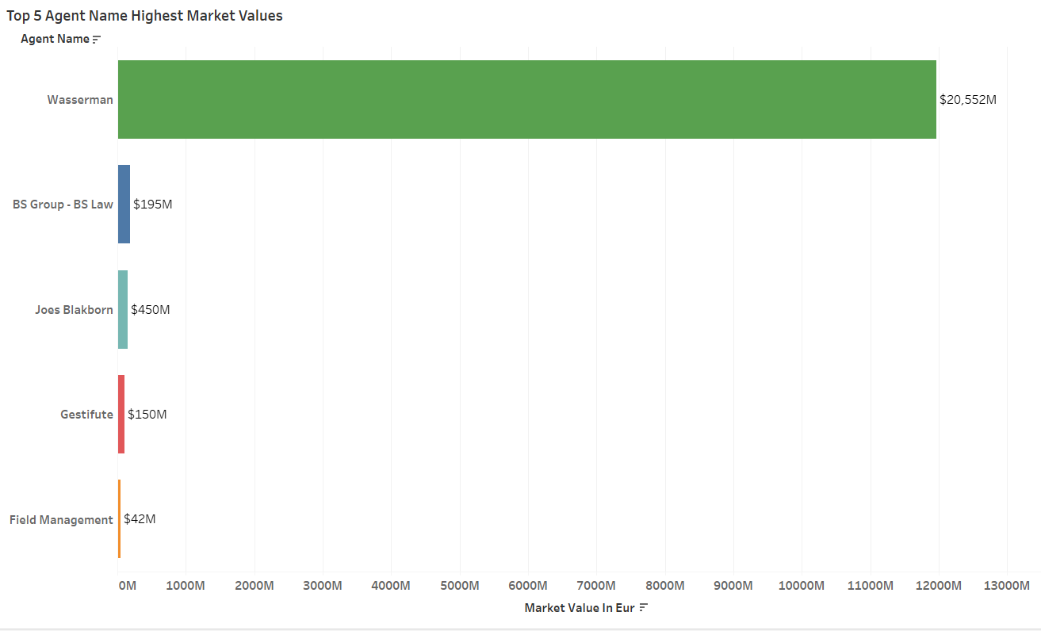
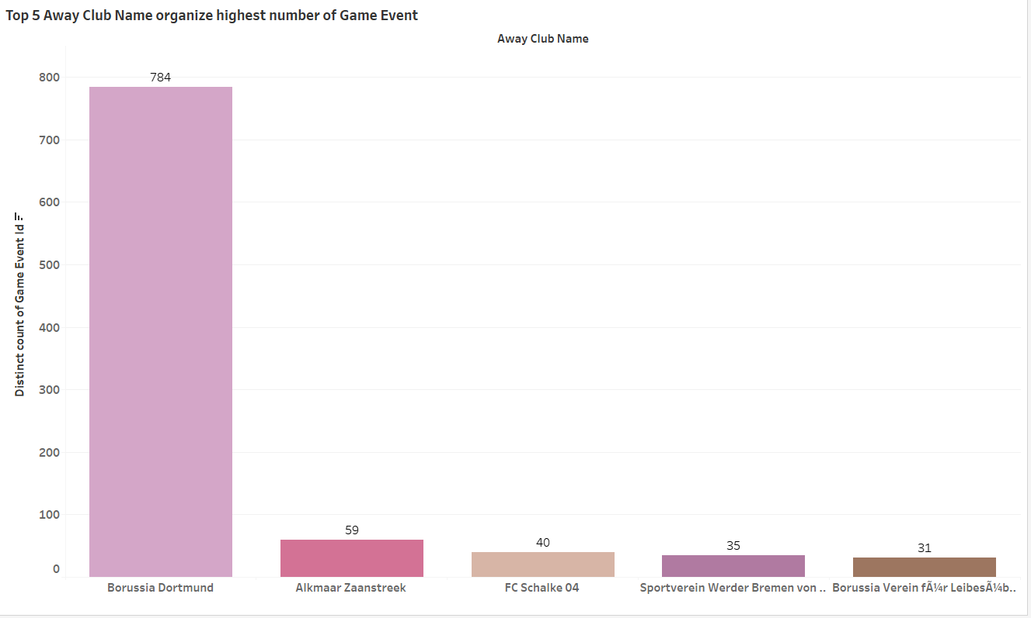
Which are he top 5 Away Club Name who organized highest number of Game event?
Which Agent have highest market values top 5?
Borussia Dortmund Club in Away Club organize highest number of Game Event
Wasserman is the highest market Value Agent

Slide 14
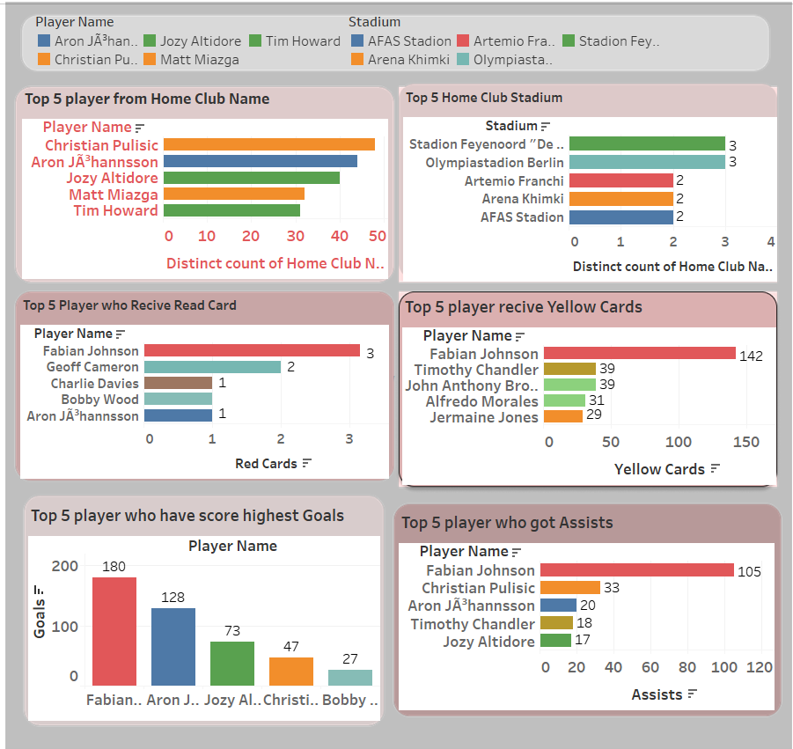
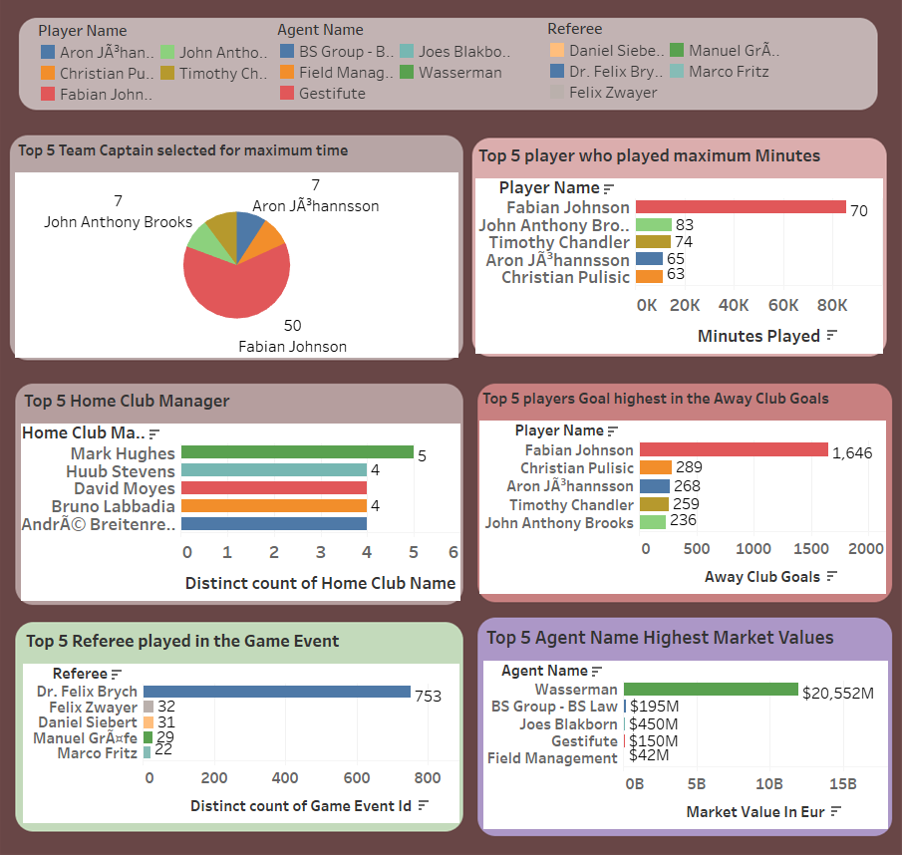
Dashboard

Slide 15
Summary
Christian Publisic is the Highest in the Home Club.
Stadion Feyenoord and Olymoliastadion Berlin has the top Home Club.
Fabian Johnson have received highest number of Red Card 3 time.
Fabian Johnson have received highest number of Yellow Card 142 time.
Highest number of Player Played Centre-Back Position.
Fabian Johnson has Score Highest number of Goals.
Febian Johnson has highest number Assists.
Fabian Johnson have selected highest number of Team Captain.
Fabian Johnson has played Maximum Minutes in the Game.
Mark Hughes is the top Home Club in the Game.

Slide 16
Summary
Fabian Johnson have played highest 1220 Season.
Fabian Johnson have got highest number of goal in the Away Club Game.
Fabian Johnson have got highest number of goal in the Home Club Game.
Fabian Johnson has highest Market Value that is $7,950M.
Signal Iduna Park is the highest Away Club Position of Stadium.
Dr. Felix Brych is the highest paid Referee in the Game.
Borussia Verein Club have organized highest number of Game Event.
Borussia Dortmund Club in Away Club organize highest number of Game Event.
Wasserman is the highest market Value Agent.

Slide 17
Conclusion
Fabian Johnson appears to be a highly influential player, achieving remarkable statistics in terms of cards, goals, assists, captaincy, and playing time. The market values and agents also reflect notable financial aspects. Stadiums and game events are associated with specific clubs, with Borussia Verein Club standing out in organizing game events. Dr. Felix Brych is noted as the highest-paid referee. However, some information, like Christian Publisic and Mark Hughes, lacks clarity and context.

Slide 18
Thank You

